Slide 1
Life Cycle Assessment for Display Products
Background
Samsung has recently performed the life cycle assessment(LCA) of its 55-inch UHD display and 24-inch monitor product to better understand potential environmental impacts may caused from the product through its whole life cycle including; pre-manufacturing; product manufacturing; distribution; product use; and disposal phase. The assessment has been completed according to international standard ISO 14040 series. Samsung has used Simapro7 software and a dedicated LCA S/W database to measure environmental impacts using a wide range of data categories including; Product bill of material (BOM), parts and components logistics, energy consumption in product use and end-of-life scenario data in order to attain the highest level of accuracy. The outcome of the LCA confirmed and quantified 12 potential environment impact categories including; global warming; abiotic depletion; eutrophication; ozone layer depletion and water consumption; where each impact category has been assessed for each life cycle stage. Critical review of this study result was done by an expert from Underwriters Laboratory(UL).
Calculation basis
System boundary of LCA
Standard | ISO 14040:2006 and 14044:2006
Database | Ecoinvent 2.2
Method for impact assessment | Life cycle impact assessment classification and characterization factors according to CML 2001 as provided in the SimaPro 7.1.5 LCA tool
LCA software | SimaPro 7.1.5
Pre-manufacturing | Parts and materials constituting the products
Manufacturing | Product assembly by Samsung Electronics (Data collection from 3 Plants)
Distribution | From Mexico/Vietnam/Slovakia/China to America, Europe and Asia countries
Usage | 7 years use
Disposal | Waste treatment of parts and material
Notes:
Impact category
1) Global Warming(GWP 100a), 2) Acidification, 3) Eutrophication, 4) Ozone Depletion, 5) Photochemical Oxidation, 6) Abiotic depletion 7) Terretrial ecotoxicity, 8) Fresh water aquatic ecotoxicity, 9) Marine aquatic ecotoxicity, 10) Human toxicity

Slide 2
Product Features
Material Use
Model name | S24E650PL
Screen Size | 24 inch
Resolution | 1920x1080
Brightness | 250cd/m2
Viewing Angle | 178°/178°
Power Supply | AC 100~240V, 50/60Hz
Wt.(kg) | 12.4 lb. (Product Weight with stand)
Characterized Environment Impact
Notes:
Impact category
1) Global Warming(GWP 100a), 2) Acidification, 3) Eutrophication, 4) Ozone Depletion, 5) Photochemical Smog Formation, 6) Primary Energy Demand, 7) Terretrial ecotoxicity, 8) Fresh water aquatic ecotoxicity, 9) Marine aquatic ecotoxicity, 10) Human toxicity, 11) Water Use

Slide 3
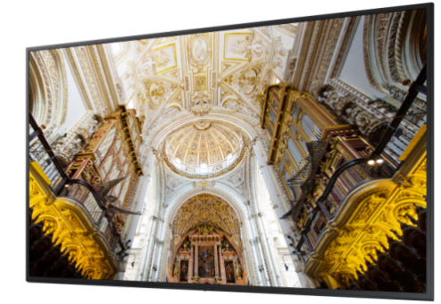
Product Features
Material Use
Model name | QM55N
Screen Size | 55 inch
Resolution | 4k UHD (3840*2160)
Brightness | 500 nit (H/V)
Viewing Angle | 178°/178°
Power Supply | AC 100 - 240 V, 50/60 Hz
Wt.(kg) | 17.4 (Package 23)
Characterized Environment Impact
Notes:
Impact category
1) Global Warming(GWP 100a), 2) Acidification, 3) Eutrophication, 4) Ozone Depletion, 5) Photochemical Smog Formation, 6) Primary Energy Demand, 7) Terretrial ecotoxicity, 8) Fresh water aquatic ecotoxicity, 9) Marine aquatic ecotoxicity, 10) Human toxicity, 11) Water Use

Slide 4
Life Cycle Assessment for Mobile Products
Background
Samsung has developed strong technical experience in assessing the life cycle environmental impacts of its smart phones. The most recent life cycle assessment (LCA) has been for the Samsung Galaxy S6; Note5; TAB E; J1x; On5x; Tab S2; Tab A 7.0; Note8; Galaxy Book model. The assessment considers potential environmental impacts across the whole life cycle including; pre-manufacturing; product manufacturing; distribution; product use; and disposal phase.
To ensure technical quality; the analysis methodology has been completed according to international standard ISO 14040 series. Samsung has used Simapro7 software and a dedicated LCA S/W database to measure environmental impacts using a wide range of data categories including; Product bill of material (BOM), parts and components logistics, energy consumption in product use and end-of-life scenario data in order to attain the highest level of accuracy. The outcome of the LCA confirmed and quantified 12 potential environment impact categories including; global warming; abiotic depletion; ocean acidification; eutrophication; and ozone layer depletion; where each impact category has been assessed for each life cycle stage. These LCA results will continue to be considered during product development phase as we aspire to improve the environmental specifications of our products.
Calculation basis
System boundary of LCA
Standard | ISO 14040:2006 and 14044:2006
Database | Ecoinvent 2.2
Method for impact assessment | Life cycle impact assessment classification and characterization factors according to CML 2001 as provided in the SimaPro 7.1.5 LCA tool
LCA software | SimaPro 7.1.5
Pre-manufacturing | Parts and materials constituting the products and its transportation (from supplier to Samsung factory)
Manufacturing | Product assembly by Samsung Electronics (Data collection period : 3 months ahead of assessment)
Distribution | From China or Vietnam to United States
Usage | 2 years use
Disposal | Waste treatment of parts and material
Critical review for Galaxy S6 LCA study was done by an expert from Korean Society for Life Cycle Assessment. (kslca@naver.com)
For the rest, it was done by internal expert in Global CS Center of Samsung Electronics. (ecodesign@samsung.com)
Notes:
Impact category
1) Global Warming(GWP 100a), 2) Acidification, 3) Eutrophication, 4) Ozone Depletion, 5) Photochemical Smog Formation, 6) Primary Energy Demand, 7) Terretrial ecotoxicity, 8) Fresh water aquatic ecotoxicity, 9) Marine aquatic ecotoxicity, 10) Human toxicity, 11) Water Use

Slide 5
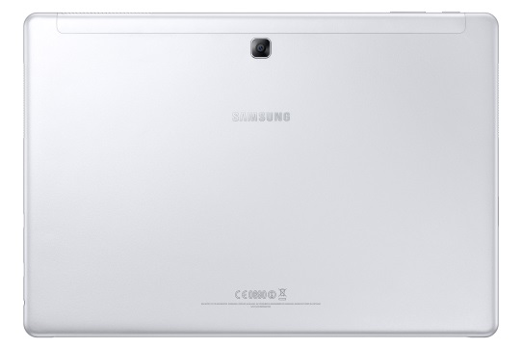
Product Features
Material Use
Model name | SM-W727V (Galaxy Book)
Processor | Intel, Core i5, 3.1GHz Dual-Core 64bit
Dimension | 199.8 * 291.3 * 7.4(H*W*D)
Display | AMOLED, OCTA, SDC, 2160 x 1440 (FHD+) 12.0", 303.7mm 16M
Battery | Li-Ion 5070 mAh
Camera | 13 MP / 5MP
Wt.(g) | 1881.9g
Characterized Environment Impact
Notes:
Impact category
1) Global Warming(GWP 100a), 2) Acidification, 3) Eutrophication, 4) Ozone Depletion, 5) Photochemical Smog Formation, 6) Primary Energy Demand, 7) Terretrial ecotoxicity, 8) Fresh water aquatic ecotoxicity, 9) Marine aquatic ecotoxicity, 10) Human toxicity, 11) Water Use

Slide 6
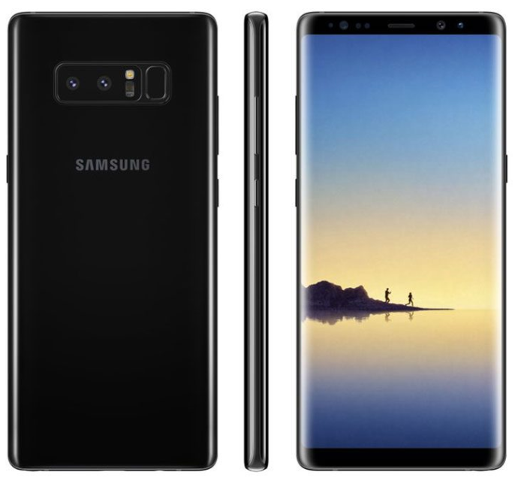
Product Features
Material Use
Model name | SM-N950U (Galaxy Note8)
Processor | Qualcomm 2.35GHz, 1.9GHz Octa-Core 64bit
Dimension | 162.5 x 74.8 x 8.6 mm
Display | 6.3" 2960 x 1440, 16M In-Cell Touch LCD
Battery | Li-Ion 3300 mAh
Camera | 12 MP / 5MP
Wt.(g) | 186.34g
Characterized Environment Impact
Notes:
Impact category
1) Global Warming(GWP 100a), 2) Acidification, 3) Eutrophication, 4) Ozone Depletion, 5) Photochemical Smog Formation, 6) Primary Energy Demand, 7) Terretrial ecotoxicity, 8) Fresh water aquatic ecotoxicity, 9) Marine aquatic ecotoxicity, 10) Human toxicity, 11) Water Use

Slide 7
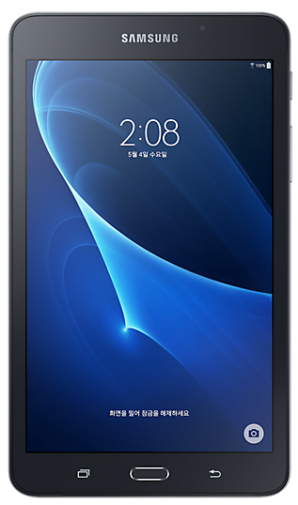
Product Features
Material Use
Model name | SM-T280 (Galaxy Tab A 7.0)
Processor | Quad-Core
Dimension | 186.9 x 108.8 x 8.7 mm
Display | 1280 x 800 (WXGA) TFT
Battery | Li-Ion 4000mAh
Camera | 5.0 MP / 2.0 MP
Wt.(g) | 283 g
Characterized Environment Impact
Notes:
Impact category
1) Global Warming(GWP 100a), 2) Acidification, 3) Eutrophication, 4) Ozone Depletion, 5) Photochemical Smog Formation, 6) Primary Energy Demand, 7) Terretrial ecotoxicity, 8) Fresh water aquatic ecotoxicity, 9) Marine aquatic ecotoxicity, 10) Human toxicity, 11) Water Use

Slide 8
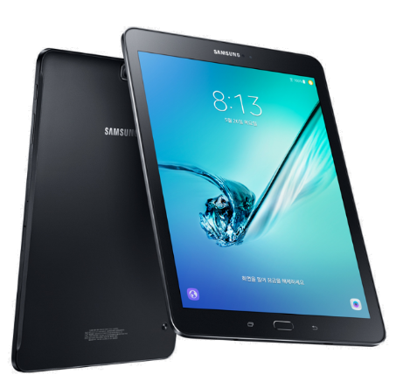
Product Features
Material Use
Model name | SM-T817V (Galaxy Tab S2)
Processor | Octa-Core 1.9 GHz, 1.3 GHz
Dimension | 237.3 x 169.0 x 5.6 mm
Display | AMOLED 10.1”
Battery | Li-Ion 5870mAh
Camera | 8 MP / 2.1MP
Wt.(g) | 379 g
Characterized Environment Impact
Notes:
Impact category
1) Global Warming(GWP 100a), 2) Acidification, 3) Eutrophication, 4) Ozone Depletion, 5) Photochemical Smog Formation, 6) Primary Energy Demand, 7) Terretrial ecotoxicity, 8) Fresh water aquatic ecotoxicity, 9) Marine aquatic ecotoxicity, 10) Human toxicity, 11) Water Use

Slide 9
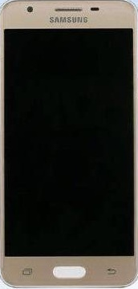
Product Features
Material Use
Model name | SM-G5510 (Galaxy On5x)
Processor | Quad-Core1.4GHz
Dimension | 142.8 x 69.5 x 8.1 mm
Display | LCD 5"
Battery | Li-Ion 2600 mAh
Camera | 12 MP / 5MP
Wt.(g) | 149 g
Characterized Environment Impact
Notes:
Impact category
1) Global Warming(GWP 100a), 2) Acidification, 3) Eutrophication, 4) Ozone Depletion, 5) Photochemical Smog Formation, 6) Primary Energy Demand, 7) Terretrial ecotoxicity, 8) Fresh water aquatic ecotoxicity, 9) Marine aquatic ecotoxicity, 10) Human toxicity, 11) Water Use

Slide 10
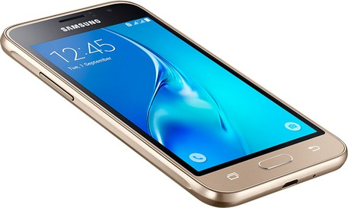
Product Features
Material Use
Model name | SM-J120A (Galaxy J1x)
Processor | Quad-core 1.2 GHz
Dimension | 132.6 x 69.3 x 8.9 mm
Display | AMOLED 4.5”
Memory | microSD, up to 128 GB
Battery | Li-Ion 2050 mAh
Camera | 5 MP
Wt.(g) | 132 g
Characterized Environment Impact
Notes:
Impact category
1) Global Warming(GWP 100a), 2) Acidification, 3) Eutrophication, 4) Ozone Depletion, 5) Photochemical Smog Formation, 6) Primary Energy Demand, 7) Terretrial ecotoxicity, 8) Fresh water aquatic ecotoxicity, 9) Marine aquatic ecotoxicity, 10) Human toxicity, 11) Water Use

Slide 11
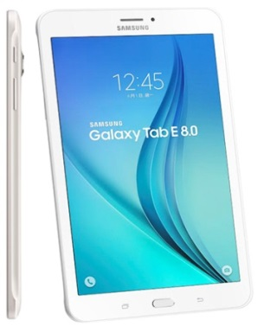
Product Features
Material Use
Model name | SM-T377P (Galaxy TAB E)
Processor | Quad-Core 1.2GHz
Dimension | 212.1 x 126.0 x 8.9 mm
Display | TFT 8.0”
Memory | 1.5GB RAM
Battery | 5000mAh
Camera | Main : 5M pixel / Front : 2M pixel
Wt.(g) | Product : 192g / Packaging 259g
Characterized Environment Impact
Notes:
Impact category
1) Global Warming(GWP 100a), 2) Acidification, 3) Eutrophication, 4) Ozone Depletion, 5) Photochemical Smog Formation, 6) Primary Energy Demand, 7) Terretrial ecotoxicity, 8) Fresh water aquatic ecotoxicity, 9) Marine aquatic ecotoxicity, 10) Human toxicity, 11) Water Use

Slide 12
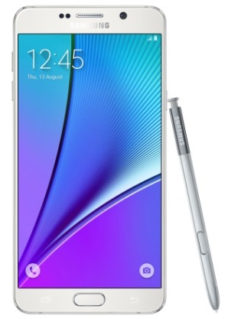
Product Features
Material Use
Model name | SM-N920V (Galaxy Note5)
Processor | Octa-Core 2.1GHz, 1.5GHz
Dimension | 153.2 x 76.2 x 7.62 mm
Display | Super AMOLED 5.7”
Memory | 32GB, 4GB RAM
Battery | 3000mAh
Camera | Main : 16M pixel / Front : 5M pixel
Wt.(g) | Product : 192g / Packaging 259 g
Characterized Environment Impact
Notes:
Impact category
1) Global Warming(GWP 100a), 2) Acidification, 3) Eutrophication, 4) Ozone Depletion, 5) Photochemical Smog Formation, 6) Primary Energy Demand, 7) Terretrial ecotoxicity, 8) Fresh water aquatic ecotoxicity, 9) Marine aquatic ecotoxicity, 10) Human toxicity, 11) Water Use

Slide 13
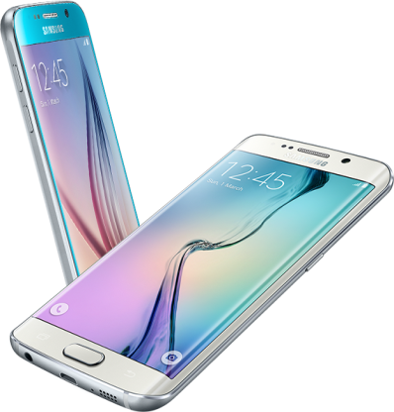
Product Features
Material Use
Model name | SM-G920V (Galaxy S6)
Processor | Octa-Core 2.1GHz, 1.5GHz
Dimension | 143.4 x 70.5 x 6.8 mm
Display | Super AMOLED 5.1”
Memory | 32GB
Battery | 2550mAh
Camera | Main : 16M pixel / Front : 5M pixel
Wt.(g) | Product : 138g / Packaging 261 g
Characterized Environment Impact
Notes:
Impact category
1) Global Warming(GWP 100a), 2) Acidification, 3) Eutrophication, 4) Ozone Depletion, 5) Photochemical Smog Formation, 6) Primary Energy Demand, 7) Terretrial ecotoxicity, 8) Fresh water aquatic ecotoxicity, 9) Marine aquatic ecotoxicity, 10) Human toxicity, 11) Water Use

Slide 14
Life Cycle Assessment for Galaxy Note20 Ultra
Background
Samsung has developed strong technical experience in assessing the life cycle environmental impacts of its smart phones. The assessment considers potential environmental impacts across the whole life cycle including; pre-manufacturing; product manufacturing; distribution; product use; and disposal phase. To ensure technical quality; the analysis methodology has been completed according to international standard ISO 14040 series. Samsung has used SimaPro 9.1.1.1 software and a dedicated LCA S/W database to measure environmental impacts using a wide range of data categories including; Product bill of material(BOM), parts and components logistics, energy consumption in product use and end-of-life scenario data in order to attain the highest level of accuracy. The outcome of the LCA confirmed and quantified 10 potential environment impact categories including; global warming; abiotic depletion; ocean acidification; eutrophication; and ozone layer depletion; where each impact category has been assessed for each life cycle stage. These LCA results will continue to be considered during product development phase as we aspire to improve the environmental specifications of our products.
Calculation basis
System boundary of LCA
Standard | ISO 14040:2006 and 14044:2006
Database | Ecoinvent 3.6
Method for impact assessment | Life cycle impact assessment classification and characterization factors according to CML 2 baseline 2000 V2.05 / the Netherlands, 1997 as provided in the SimaPro 9.1.1.1 LCA tool
LCA software | SimaPro 9.1.1.1
Pre-manufacturing | Parts and materials constituting the products and its transportation
Manufacturing | Product assembly by Samsung Electronics
Distribution | From Korea to EU
Use | 2 years use
Disposal | Waste treatment of parts and material
Critical review for LCA study was done by internal expert in Global CS Center of Samsung Electronics. (ecodesign@samsung.com)

Slide 15
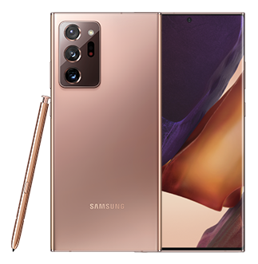
Product Features
Numerical environmental impact
Model name | SM-N986B (Galaxy Note20 Ultra)
Processor | Octa-Core 3.09GHz,2.4GHz,1.8GHz
Dimension | 164.8 × 77.2 × 8.1mm
Display | OLED 6.9”
Memory | ROM 256GB, RAM 12GB
Battery | 4500 mAh
Camera | Main : 108M pixel / Sub : 10M pixel
Weight | Product&Acc. : 303.79g / PKG 252.14g
Impact category | Total | Unit | Pre-Manu facturing | Manu facturing | Distribution | Use | Disposal
Abiotic depletion | 1.69E-01 | kg Sb eq. | 1.01E-01 | 1.05E-03 | 1.00E-05 | 6.63E-02 | 5.22E-04
Acidification | 1.88E-01 | kg SO₂ eq. | 1.25E-01 | 2.17E-03 | 2.01E-02 | 4.03E-02 | 5.63E-04
Eutrophication | 9.56E-02 | kgPO₄³⁻eq. | 7.33E-02 | 5.72E-04 | 3.43E-03 | 1.78E-02 | 5.24E-04
Global warming (GWP100) | 2.97E+01 | kg CO₂ eq. | 1.37E+01 | 1.18E+00 | 5.28E+00 | 9.10E+00 | 5.02E-01
Ozone layer depletion (ODP) | 2.46E-06 | kg CFC-11 eq. | 1.39E-06 | 3.27E-11 | 6.72E-07 | 3.85E-07 | 1.13E-08
Human toxicity | 1.06E+02 | kg 1,4-DB eq. | 9.12E+01 | 5.03E-05 | 4.26E+00 | 7.68E+00 | 2.62E+00
Fresh water aquatic ecotox. | 8.71E+01 | kg 1,4-DB eq. | 7.98E+01 | 1.03E-04 | 3.76E-02 | 6.43E+00 | 8.40E-01
Marine aquatic ecotoxicity | 1.31E+05 | kg 1,4-DB eq. | 1.21E+05 | 8.60E-02 | 3.71E+02 | 8.80E+03 | 5.11E+02
Terrestrial ecotoxicity | 2.09E-01 | kg 1,4-DB eq. | 1.49E-01 | 3.13E-06 | 4.60E-03 | 5.50E-02 | 7.38E-04
Photochemical oxidation | 6.59E-03 | kg C₂H₄ eq. | 5.27E-03 | -1.21E-03 | 8.52E-04 | 1.60E-03 | 7.47E-05
Characterized Environment Impact
Notes:
Impact category
1) Abiotic depletion, 2) Acidification, 3) Eutrophication, 4) Global warming(GWP100), 5) Ozone layer depletion(ODP), 6) Human toxicity, 7) Fresh water aquatic ecotoxicity, 8) Marine aquatic ecotoxicity, 9) Terrestrial ecotoxicity, 10) Photochemical oxidation

Slide 16
Life Cycle Assessment for Galaxy Tab S7+
Background
Samsung has developed strong technical experience in assessing the life cycle environmental impacts of its Tablets. The assessment considers potential environmental impacts across the whole life cycle including; pre-manufacturing; product manufacturing; distribution; product use; and disposal phase. To ensure technical quality; the analysis methodology has been completed according to international standard ISO 14040 series. Samsung has used SimaPro 9.1.1.1 software and a dedicated LCA S/W database to measure environmental impacts using a wide range of data categories including; Product bill of material(BOM), parts and components logistics, energy consumption in product use and end-of-life scenario data in order to attain the highest level of accuracy. The outcome of the LCA confirmed and quantified 10 potential environment impact categories including; global warming; abiotic depletion; ocean acidification; eutrophication; and ozone layer depletion; where each impact category has been assessed for each life cycle stage. These LCA results will continue to be considered during product development phase as we aspire to improve the environmental specifications of our products.
Calculation basis
System boundary of LCA
Standard | ISO 14040:2006 and 14044:2006
Database | Ecoinvent 3.6
Method for impact assessment | Life cycle impact assessment classification and characterization factors according to CML 2 baseline 2000 V2.05 / the Netherlands, 1997 as provided in the SimaPro 9.1.1.1 LCA tool
LCA software | SimaPro 9.1.1.1
Pre-manufacturing | Parts and materials constituting the products and its transportation
Manufacturing | Product assembly by Samsung Electronics
Distribution | From Korea to EU
Use | 2 years use
Disposal | Waste treatment of parts and material
Critical review for LCA study was done by internal expert in Global CS Center of Samsung Electronics. (ecodesign@samsung.com)

Slide 17
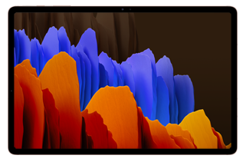
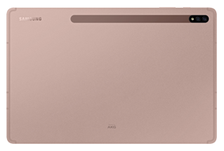
Product Features
Numerical environmental impact
Model name | SM-T976B (Galaxy Tab S7+)
Processor | Qualcomm, SM8250 Pro, 3.09GHz, 2.4GHz,1.8GHz Octa-Core 64bit
Dimension | 185.0 × 285.0 × 5.7mm
Display | AMOLED 12.4”
Memory | ROM 128GB, RAM 6GB
Battery | 9800 mAh
Camera | Main : 13.0M pixel / Sub : 8.0M pixel
Weight | Product&Acc. : 644.83g / PKG : 301.80g
Impact category | Total | Unit | Pre-Manu facturing | Manu facturing | Distribution | Use | Disposal
Abiotic depletion | 2.81E-01 | kg Sb eq. | 7.22E-02 | 1.05E-03 | 1.80E-05 | 2.06E-01 | 1.22E-03
Acidification | 2.83E-01 | kg SO₂ eq. | 1.18E-01 | 2.17E-03 | 3.61E-02 | 1.25E-01 | 1.09E-03
Eutrophication | 1.19E-01 | kgPO₄³⁻eq. | 5.65E-02 | 5.72E-04 | 6.17E-03 | 5.53E-02 | 8.61E-04
Global warming (GWP100) | 5.12E+01 | kg CO₂ eq. | 1.17E+01 | 1.18E+00 | 9.49E+00 | 2.83E+01 | 5.44E-01
Ozone layer depletion (ODP) | 3.66E-06 | kg CFC-11 eq. | 1.23E-06 | 3.27E-11 | 1.21E-06 | 1.20E-06 | 2.23E-08
Human toxicity | 1.14E+02 | kg 1,4-DB eq. | 8.05E+01 | 5.03E-05 | 7.66E+00 | 2.39E+01 | 2.16E+00
Fresh water aquatic ecotox. | 8.55E+01 | kg 1,4-DB eq. | 6.43E+01 | 1.03E-04 | 6.76E-02 | 2.00E+01 | 1.11E+00
Marine aquatic ecotoxicity | 1.18E+05 | kg 1,4-DB eq. | 8.90E+04 | 8.60E-02 | 6.67E+02 | 2.74E+04 | 7.06E+02
Terrestrial ecotoxicity | 3.12E-01 | kg 1,4-DB eq. | 1.31E-01 | 3.13E-06 | 8.27E-03 | 1.71E-01 | 1.23E-03
Photochemical oxidation | 1.10E-02 | kg C₂H₄ eq. | 5.54E-03 | -1.21E-03 | 1.53E-03 | 4.97E-03 | 1.48E-04
Characterized Environment Impact
Notes:
Impact category
1) Abiotic depletion, 2) Acidification, 3) Eutrophication, 4) Global warming(GWP100), 5) Ozone layer depletion(ODP), 6) Human toxicity, 7) Fresh water aquatic ecotoxicity, 8) Marine aquatic ecotoxicity, 9) Terrestrial ecotoxicity, 10) Photochemical oxidation

Slide 18
Life Cycle Assessment for Galaxy Tab S7
Background
Samsung has developed strong technical experience in assessing the life cycle environmental impacts of its Tablets. The assessment considers potential environmental impacts across the whole life cycle including; pre-manufacturing; product manufacturing; distribution; product use; and disposal phase. To ensure technical quality; the analysis methodology has been completed according to international standard ISO 14040 series. Samsung has used SimaPro 9.1.1.1 software and a dedicated LCA S/W database to measure environmental impacts using a wide range of data categories including; Product bill of material(BOM), parts and components logistics, energy consumption in product use and end-of-life scenario data in order to attain the highest level of accuracy. The outcome of the LCA confirmed and quantified 10 potential environment impact categories including; global warming; abiotic depletion; ocean acidification; eutrophication; and ozone layer depletion; where each impact category has been assessed for each life cycle stage. These LCA results will continue to be considered during product development phase as we aspire to improve the environmental specifications of our products.
Calculation basis
System boundary of LCA
Standard | ISO 14040:2006 and 14044:2006
Database | Ecoinvent 3.6
Method for impact assessment | Life cycle impact assessment classification and characterization factors according to CML 2 baseline 2000 V2.05 / the Netherlands, 1997 as provided in the SimaPro 9.1.1.1 LCA tool
LCA software | SimaPro 9.1.1.1
Pre-manufacturing | Parts and materials constituting the products and its transportation
Manufacturing | Product assembly by Samsung Electronics
Distribution | From Korea to EU
Use | 2 years use
Disposal | Waste treatment of parts and material
Critical review for LCA study was done by internal expert in Global CS Center of Samsung Electronics. (ecodesign@samsung.com)

Slide 19
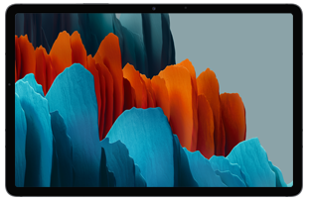
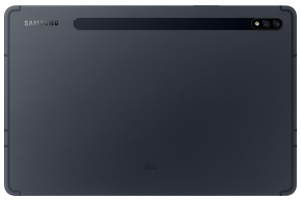
Product Features
Numerical environmental impact
Model name | SM-T875 (Galaxy Tab S7)
Processor | Qualcomm, SM8250 Pro, 3.09GHz, 2.4GHz,1.8GHz Octa-Core 64bit
Dimension | 165.3 × 253.8 × 6.3mm
Display | In-Cell Touch LCD 10.95”
Memory | ROM 128GB, RAM 6GB
Battery | 7760 mAh
Camera | Main : 13.0M pixel / Sub : 8.0M pixel
Weight | Product&Acc. : 574.49g / PKG : 270.26g
Impact category | Total | Unit | Pre-Manu facturing | Manu facturing | Distribution | Use | Disposal
Abiotic depletion | 2.73E-01 | kg Sb eq. | 1.36E-01 | 1.05E-03 | 1.52E-05 | 1.35E-01 | 9.71E-04
Acidification | 3.06E-01 | kg SO₂ eq. | 1.90E-01 | 2.17E-03 | 3.05E-02 | 8.21E-02 | 8.80E-04
Eutrophication | 1.65E-01 | kgPO₄³⁻eq. | 1.22E-01 | 5.72E-04 | 5.21E-03 | 3.62E-02 | 8.17E-04
Global warming (GWP100) | 4.82E+01 | kg CO₂ eq. | 1.99E+01 | 1.18E+00 | 8.02E+00 | 1.86E+01 | 5.34E-01
Ozone layer depletion (ODP) | 3.65E-06 | kg CFC-11 eq. | 1.82E-06 | 3.27E-11 | 1.02E-06 | 7.86E-07 | 1.97E-08
Human toxicity | 1.76E+02 | kg 1,4-DB eq. | 1.52E+02 | 5.03E-05 | 6.47E+00 | 1.57E+01 | 2.18E+00
Fresh water aquatic ecotox. | 1.53E+02 | kg 1,4-DB eq. | 1.39E+02 | 1.03E-04 | 5.71E-02 | 1.31E+01 | 1.18E+00
Marine aquatic ecotoxicity | 2.02E+05 | kg 1,4-DB eq. | 1.83E+05 | 8.60E-02 | 5.63E+02 | 1.79E+04 | 7.03E+02
Terrestrial ecotoxicity | 3.23E-01 | kg 1,4-DB eq. | 2.03E-01 | 3.13E-06 | 6.99E-03 | 1.12E-01 | 1.03E-03
Photochemical oxidation | 1.15E-02 | kg C₂H₄ eq. | 8.03E-03 | -1.21E-03 | 1.29E-03 | 3.26E-03 | 1.34E-04
Characterized Environment Impact
Notes:
Impact category
1) Abiotic depletion, 2) Acidification, 3) Eutrophication, 4) Global warming(GWP100), 5) Ozone layer depletion(ODP), 6) Human toxicity, 7) Fresh water aquatic ecotoxicity, 8) Marine aquatic ecotoxicity, 9) Terrestrial ecotoxicity, 10) Photochemical oxidation

Slide 20
Life Cycle Assessment for Galaxy Z Fold3
Background
Samsung has developed strong technical experience in assessing the life cycle environmental impacts of its smart phones. The assessment considers potential environmental impacts across the whole life cycle including; pre-manufacturing; product manufacturing; distribution; product use; and disposal phase. To ensure technical quality; the analysis methodology has been completed according to international standard ISO 14040 series. Samsung has used SimaPro 9.1.1.1 software and a dedicated LCA S/W database to measure environmental impacts using a wide range of data categories including; Product bill of material(BOM), parts and components logistics, energy consumption in product use and end-of-life scenario data in order to attain the highest level of accuracy. The outcome of the LCA confirmed and quantified 10 potential environment impact categories including; global warming; abiotic depletion; ocean acidification; eutrophication; and ozone layer depletion; where each impact category has been assessed for each life cycle stage. These LCA results will continue to be considered during product development phase as we aspire to improve the environmental specifications of our products.
Calculation basis
System boundary of LCA
Standard | ISO 14040:2006 and 14044:2006
Database | Ecoinvent 3.6
Method for impact assessment | Life cycle impact assessment classification and characterization factors according to CML 2 baseline 2000 V2.05 / the Netherlands, 1997 as provided in the SimaPro 9.1.1.1 LCA tool
LCA software | SimaPro 9.1.1.1
Pre-manufacturing | Parts and materials constituting the products and its transportation
Manufacturing | Product assembly by Samsung Electronics
Distribution | From Korea to EU
Use | 2 years use
Disposal | Waste treatment of parts and material
Critical review for LCA study was done by internal expert in Global CS Center of Samsung Electronics. (ecodesign@samsung.com)

Slide 21
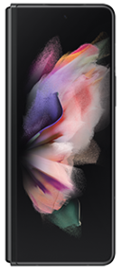
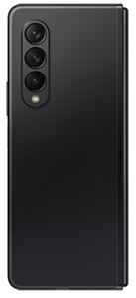
Product Features
Numerical environmental impact
Model name | SM-F926B (Galaxy Z Fold3)
Processor | Qualcomm, SM8350, 2.84GHz,2.4GHz,1.8GHz Octa-Core 64bit
Dimension | 158.2 * 128.1 * 6.4mm
Display | Main OLED 7.6”, SUB 6.2”
Memory | ROM 256GB, RAM 12GB
Battery | 4275 mAh
Camera | Main : 12.0M pixel / Sub : 4.0M pixel
Weight | Product&Acc. : 290.16g / PKG : 209.87g
Impact category | Total | Unit | Pre-Manu facturing | Manu facturing | Distribution | Use | Disposal
Abiotic depletion | 1.97E-01 | kg Sb eq. | 1.06E-01 | 1.42E-03 | 8.99E-06 | 8.92E-02 | 6.64E-04
Acidification | 1.72E-01 | kg SO₂ eq | 9.58E-02 | 2.95E-03 | 1.80E-02 | 5.41E-02 | 6.35E-04
Eutrophication | 1.03E-01 | kg PO₄³⁻eq | 7.51E-02 | 7.78E-04 | 3.08E-03 | 2.39E-02 | 4.95E-04
Global warming (GWP100) | 3.23E+01 | kg CO₂ eq | 1.34E+01 | 1.61E+00 | 4.74E+00 | 1.22E+01 | 3.38E-01
Ozone layer depletion (ODP) | 2.49E-06 | kg CFC11 eq | 1.36E-06 | 4.45E-11 | 6.03E-07 | 5.18E-07 | 1.18E-08
Human toxicity | 1.05E+02 | kg 1,4-DB eq | 8.98E+01 | 6.84E-05 | 3.83E+00 | 1.03E+01 | 1.40E+00
Fresh water aquatic ecotox. | 8.56E+01 | kg 1,4-DB eq | 7.57E+01 | 1.39E-04 | 3.38E-02 | 8.64E+00 | 1.20E+00
Marine aquatic ecotoxicity | 1.25E+05 | kg 1,4-DB eq | 1.12E+05 | 1.17E-01 | 3.33E+02 | 1.18E+04 | 5.53E+02
Terrestrial ecotoxicity | 2.22E-01 | kg 1,4-DB eq | 1.44E-01 | 4.26E-06 | 4.13E-03 | 7.39E-02 | 6.96E-04
Photochemical oxidation | 5.27E-03 | kg C₂H₄ eq. | 3.92E-03 | -1.64E-03 | 7.65E-04 | 2.15E-03 | 8.25E-05
Characterized Environment Impact
Notes:
Impact category
1) Abiotic depletion, 2) Acidification, 3) Eutrophication, 4) Global warming(GWP100), 5) Ozone layer depletion(ODP), 6) Human toxicity, 7) Fresh water aquatic ecotoxicity, 8) Marine aquatic ecotoxicity, 9) Terrestrial ecotoxicity, 10) Photochemical oxidation

Slide 22
Life Cycle Assessment for Galaxy Z Flip3
Background
Samsung has developed strong technical experience in assessing the life cycle environmental impacts of its smart phones. The assessment considers potential environmental impacts across the whole life cycle including; pre-manufacturing; product manufacturing; distribution; product use; and disposal phase. To ensure technical quality; the analysis methodology has been completed according to international standard ISO 14040 series. Samsung has used SimaPro 9.1.1.1 software and a dedicated LCA S/W database to measure environmental impacts using a wide range of data categories including; Product bill of material(BOM), parts and components logistics, energy consumption in product use and end-of-life scenario data in order to attain the highest level of accuracy. The outcome of the LCA confirmed and quantified 10 potential environment impact categories including; global warming; abiotic depletion; ocean acidification; eutrophication; and ozone layer depletion; where each impact category has been assessed for each life cycle stage. These LCA results will continue to be considered during product development phase as we aspire to improve the environmental specifications of our products.
Calculation basis
System boundary of LCA
Standard | ISO 14040:2006 and 14044:2006
Database | Ecoinvent 3.6
Method for impact assessment | Life cycle impact assessment classification and characterization factors according to CML 2 baseline 2000 V2.05 / the Netherlands, 1997 as provided in the SimaPro 9.1.1.1 LCA tool
LCA software | SimaPro 9.1.1.1
Pre-manufacturing | Parts and materials constituting the products and its transportation
Manufacturing | Product assembly by Samsung Electronics
Distribution | From Korea to EU
Use | 2 years use
Disposal | Waste treatment of parts and material
Critical review for LCA study was done by internal expert in Global CS Center of Samsung Electronics. (ecodesign@samsung.com)

Slide 23
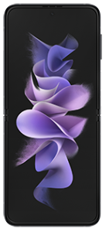
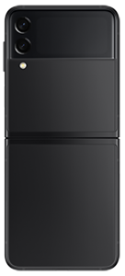
Product Features
Global Warming Impact of Part
Model name | SM-F711B (Galaxy Z Flip3)
Processor | Qualcomm, SM8350, 2.84GHz,2.4GHz,1.8GHz Octa-Core 64bit
Dimension | 166.0 * 72.2 * - mm
Display | Main OLED 6.7”, SUB 1.9”
Memory | ROM 128GB, RAM 8GB
Battery | 3300 mAh
Camera | Main : 12.0M pixel / Sub : 10.0M pixel
Weight | Product&Acc. : 209.49g / PKG : 142.25g
Characterized Environment Impact
kg Sb eq.
kg SO₂ eq.
kgPO₄³-eq.
kg CO₂ eq.
kg CFC-11 eq.
kg 1,4-DB eq.
kg 1,4-DB eq.
kg 1,4-DB eq.
kg 1,4-DB eq.
kg C₂H₄ eq.

Slide 24
Life Cycle Assessment for Galaxy A12
Background
Samsung has developed strong technical experience in assessing the life cycle environmental impacts of its smart phones. The assessment considers potential environmental impacts across the whole life cycle including; pre-manufacturing; product manufacturing; distribution; product use; and disposal phase. To ensure technical quality; the analysis methodology has been completed according to international standard ISO 14040 series. Samsung has used SimaPro 9.1.1.1 software and a dedicated LCA S/W database to measure environmental impacts using a wide range of data categories including; Product bill of material(BOM), parts and components logistics, energy consumption in product use and end-of-life scenario data in order to attain the highest level of accuracy. The outcome of the LCA confirmed and quantified 10 potential environment impact categories including; global warming; abiotic depletion; ocean acidification; eutrophication; and ozone layer depletion; where each impact category has been assessed for each life cycle stage. These LCA results will continue to be considered during product development phase as we aspire to improve the environmental specifications of our products.
Calculation basis
System boundary of LCA
Standard | ISO 14040:2006 and 14044:2006
Database | Ecoinvent 3.6
Method for impact assessment | Life cycle impact assessment classification and characterization factors according to CML 2 baseline 2000 V2.05 / the Netherlands, 1997 as provided in the SimaPro 9.1.1.1 LCA tool
LCA software | SimaPro 9.1.1.1
Pre-manufacturing | Parts and materials constituting the products and its transportation
Manufacturing | Product assembly by Samsung Electronics
Distribution | From Korea to EU
Use | 2 years use
Disposal | Waste treatment of parts and material
Critical review for LCA study was done by internal expert in Global CS Center of Samsung Electronics. (ecodesign@samsung.com)

Slide 25
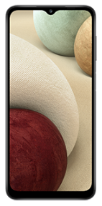
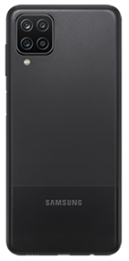
Product Features
Numerical environmental impact
Model name | SM-A127F (Galaxy A12)
Processor | SEC, S5E3830(Exynos 850), 2GHz Octa-Core 64bit
Dimension | 164 × 75.8 × 8.9mm
Display | In-Cell Touch LCD 6.5”
Memory | ROM 32GB, RAM 3GB
Battery | 4900 mAh
Camera | Main : 48.0M pixel / Sub : 8.0M pixel
Weight | Product&Acc. : 268.45g / PKG : 93.77g
Impact category | Total | Unit | Pre-Manu facturing | Manu facturing | Distribution | Use | Disposal
Abiotic depletion | 1.20E-01 | kg Sb eq. | 6.49E-02 | 1.08E-03 | 6.52E-06 | 5.34E-02 | 5.31E-04
Acidification | 1.16E-01 | kg SO₂ eq. | 6.81E-02 | 2.25E-03 | 1.31E-02 | 3.24E-02 | 5.67E-04
Eutrophication | 6.51E-02 | kgPO₄³-eq. | 4.76E-02 | 5.94E-04 | 2.23E-03 | 1.43E-02 | 3.96E-04
Global warming (GWP100) | 2.05E+01 | kg CO₂ eq. | 8.24E+00 | 1.23E+00 | 3.44E+00 | 7.32E+00 | 2.92E-01
Ozone layer depletion (ODP) | 1.51E-06 | kg CFC-11 eq. | 7.48E-07 | 3.39E-11 | 4.37E-07 | 3.10E-07 | 1.10E-08
Human toxicity | 7.76E+01 | kg 1,4-DB eq. | 6.73E+01 | 5.22E-05 | 2.77E+00 | 6.18E+00 | 1.32E+00
Fresh water aquatic ecotox. | 5.51E+01 | kg 1,4-DB eq. | 4.89E+01 | 1.06E-04 | 2.45E-02 | 5.17E+00 | 1.06E+00
Marine aquatic ecotoxicity | 7.52E+04 | kg 1,4-DB eq. | 6.74E+04 | 8.92E-02 | 2.41E+02 | 7.08E+03 | 4.96E+02
Terrestrial ecotoxicity | 1.50E-01 | kg 1,4-DB eq. | 1.02E-01 | 3.25E-06 | 3.00E-03 | 4.42E-02 | 5.83E-04
Photochemical oxidation | 3.47E-03 | kg C₂H₄ eq. | 2.81E-03 | -1.25E-03 | 5.54E-04 | 1.29E-03 | 7.23E-05
Characterized Environment Impact
Notes:
Impact category
1) Abiotic depletion, 2) Acidification, 3) Eutrophication, 4) Global warming(GWP100), 5) Ozone layer depletion(ODP), 6) Human toxicity, 7) Fresh water aquatic ecotoxicity, 8) Marine aquatic ecotoxicity, 9) Terrestrial ecotoxicity, 10) Photochemical oxidation

Slide 26
Life Cycle Assessment for Galaxy S20 FE
Background
Samsung has developed strong technical experience in assessing the life cycle environmental impacts of its smart phones. The assessment considers potential environmental impacts across the whole life cycle including; pre-manufacturing; product manufacturing; distribution; product use; and disposal phase. To ensure technical quality; the analysis methodology has been completed according to international standard ISO 14040 series. Samsung has used SimaPro 9.1.1.1 software and a dedicated LCA S/W database to measure environmental impacts using a wide range of data categories including; Product bill of material(BOM), parts and components logistics, energy consumption in product use and end-of-life scenario data in order to attain the highest level of accuracy. The outcome of the LCA confirmed and quantified 10 potential environment impact categories including; global warming; abiotic depletion; ocean acidification; eutrophication; and ozone layer depletion; where each impact category has been assessed for each life cycle stage. These LCA results will continue to be considered during product development phase as we aspire to improve the environmental specifications of our products.
Calculation basis
System boundary of LCA
Standard | ISO 14040:2006 and 14044:2006
Database | Ecoinvent 3.6
Method for impact assessment | Life cycle impact assessment classification and characterization factors according to CML 2 baseline 2000 V2.05 / the Netherlands, 1997 as provided in the SimaPro 9.1.1.1 LCA tool
LCA software | SimaPro 9.1.1.1
Pre-manufacturing | Parts and materials constituting the products and its transportation
Manufacturing | Product assembly by Samsung Electronics
Distribution | From Korea to EU
Use | 2 years use
Disposal | Waste treatment of parts and material
Critical review for LCA study was done by internal expert in Global CS Center of Samsung Electronics. (ecodesign@samsung.com)

Slide 27
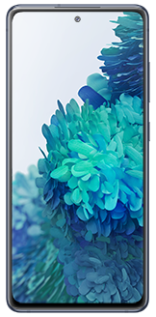
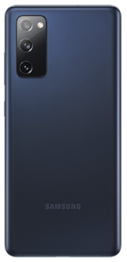
Product Features
Numerical environmental impact
Model name | SM-G781B (Galaxy S20 FE)
Processor | Qualcomm, SM8250, 2.8GHz,2.4GHz, 1.8GHz Octa-Core 64bit
Dimension | 159.8 * 74.5 * 8.4mm
Display | On-Cell Touch AMOLED, 6.5”
Memory | ROM 128GB, RAM 6GB
Battery | 4370 mAh
Camera | Main : 12.0M pixel / Sub : 32.0M pixel
Weight | Product&Acc. : 253.74g / PKG : 229.66g
Impact category | Total | Unit | Pre-Manu facturing | Manu facturing | Distribution | Use | Disposal
Abiotic depletion | 1.40E-01 | kg Sb eq. | 6.72E-02 | 1.62E-03 | 8.69E-06 | 7.03E-02 | 4.74E-04
Acidification | 1.37E-01 | kg SO₂ eq. | 7.29E-02 | 3.37E-03 | 1.74E-02 | 4.27E-02 | 3.07E-04
Eutrophication | 7.30E-02 | kgPO₄³-eq. | 4.98E-02 | 8.88E-04 | 2.97E-03 | 1.88E-02 | 5.15E-04
Global warming (GWP100) | 2.50E+01 | kg CO₂ eq. | 8.63E+00 | 1.84E+00 | 4.58E+00 | 9.64E+00 | 3.56E-01
Ozone layer depletion (ODP) | 1.83E-06 | kg CFC-11 eq. | 8.22E-07 | 5.08E-11 | 5.83E-07 | 4.08E-07 | 1.72E-08
Human toxicity | 8.20E+01 | kg 1,4-DB eq. | 6.92E+01 | 7.81E-05 | 3.69E+00 | 8.14E+00 | 1.03E+00
Fresh water aquatic ecotox. | 6.02E+01 | kg 1,4-DB eq. | 5.25E+01 | 1.59E-04 | 3.26E-02 | 6.81E+00 | 8.05E-01
Marine aquatic ecotoxicity | 8.41E+04 | kg 1,4-DB eq. | 7.40E+04 | 1.33E-01 | 3.22E+02 | 9.33E+03 | 4.84E+02
Terrestrial ecotoxicity | 1.67E-01 | kg 1,4-DB eq. | 1.04E-01 | 4.86E-06 | 3.99E-03 | 5.83E-02 | 4.36E-04
Photochemical oxidation | 3.70E-03 | kg C₂H₄ eq. | 3.03E-03 | -1.88E-03 | 7.39E-04 | 1.69E-03 | 1.14E-04
Characterized Environment Impact
Notes:
Impact category
1) Abiotic depletion, 2) Acidification, 3) Eutrophication, 4) Global warming(GWP100), 5) Ozone layer depletion(ODP), 6) Human toxicity, 7) Fresh water aquatic ecotoxicity, 8) Marine aquatic ecotoxicity, 9) Terrestrial ecotoxicity, 10) Photochemical oxidation

Slide 28
Life Cycle Assessment for Galaxy Tab Active Pro
Background
Samsung has developed strong technical experience in assessing the life cycle environmental impacts of its Tablets. The assessment considers potential environmental impacts across the whole life cycle including; pre-manufacturing; product manufacturing; distribution; product use; and disposal phase. To ensure technical quality; the analysis methodology has been completed according to international standard ISO 14040 series. Samsung has used SimaPro 9.1.1.1 software and a dedicated LCA S/W database to measure environmental impacts using a wide range of data categories including; Product bill of material(BOM), parts and components logistics, energy consumption in product use and end-of-life scenario data in order to attain the highest level of accuracy. The outcome of the LCA confirmed and quantified 10 potential environment impact categories including; global warming; abiotic depletion; ocean acidification; eutrophication; and ozone layer depletion; where each impact category has been assessed for each life cycle stage. These LCA results will continue to be considered during product development phase as we aspire to improve the environmental specifications of our products.
Calculation basis
System boundary of LCA
Standard | ISO 14040:2006 and 14044:2006
Database | Ecoinvent 3.6
Method for impact assessment | Life cycle impact assessment classification and characterization factors according to CML 2 baseline 2000 V2.05 / the Netherlands, 1997 as provided in the SimaPro 9.1.1.1 LCA tool
LCA software | SimaPro 9.1.1.1
Pre-manufacturing | Parts and materials constituting the products and its transportation
Manufacturing | Product assembly by Samsung Electronics
Distribution | From Korea to EU
Use | 2 years use
Disposal | Waste treatment of parts and material
Critical review for LCA study was done by internal expert in Global CS Center of Samsung Electronics. (ecodesign@samsung.com)

Slide 29
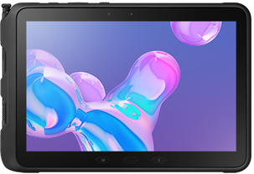
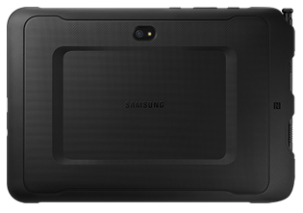
Product Features
Numerical environmental impact
Model name | SM-T545 (Galaxy Tab Active Pro)
Processor | Qualcomm, SDM670, 2GHz,1.7GHz Octa-Core 64bit
Dimension | 170.2 * 243.5 * 9.9mm
Display | LCD, 10.1"
Memory | ROM 64GB, RAM 4GB
Battery | 7400 mAh
Camera | Main : 13.0M pixel / Sub : 8.0M pixel
Weight | Product&Acc. : 948.94g / PKG : 520.43g
Impact category | Total | Unit | Pre-Manu facturing | Manu facturing | Distribution | Use | Disposal
Abiotic depletion | 2.99E-01 | kg Sb eq. | 1.89E-01 | 1.97E-03 | 2.65E-05 | 1.07E-01 | 1.19E-03
Acidification | 3.02E-01 | kg SO₂ eq. | 1.79E-01 | 4.09E-03 | 5.30E-02 | 6.48E-02 | 1.10E-03
Eutrophication | 1.63E-01 | kgPO₄³-eq. | 1.22E-01 | 1.08E-03 | 9.06E-03 | 2.86E-02 | 1.67E-03
Global warming (GWP100) | 6.28E+01 | kg CO₂ eq. | 3.06E+01 | 2.23E+00 | 1.40E+01 | 1.46E+01 | 1.39E+00
Ozone layer depletion (ODP) | 4.37E-06 | kg CFC-11 eq. | 1.93E-06 | 6.16E-11 | 1.78E-06 | 6.20E-07 | 4.23E-08
Human toxicity | 1.86E+02 | kg 1,4-DB eq. | 1.56E+02 | 9.47E-05 | 1.13E+01 | 1.24E+01 | 6.71E+00
Fresh water aquatic ecotox. | 1.22E+02 | kg 1,4-DB eq. | 1.08E+02 | 1.93E-04 | 9.94E-02 | 1.03E+01 | 3.36E+00
Marine aquatic ecotoxicity | 1.71E+05 | kg 1,4-DB eq. | 1.54E+05 | 1.62E-01 | 9.80E+02 | 1.42E+04 | 1.84E+03
Terrestrial ecotoxicity | 3.59E-01 | kg 1,4-DB eq. | 2.57E-01 | 5.90E-06 | 1.22E-02 | 8.85E-02 | 1.39E-03
Photochemical oxidation | 1.08E-02 | kg C₂H₄ eq. | 8.01E-03 | -2.28E-03 | 2.25E-03 | 2.57E-03 | 2.86E-04
Characterized Environment Impact
Notes:
Impact category
1) Abiotic depletion, 2) Acidification, 3) Eutrophication, 4) Global warming(GWP100), 5) Ozone layer depletion(ODP), 6) Human toxicity, 7) Fresh water aquatic ecotoxicity, 8) Marine aquatic ecotoxicity, 9) Terrestrial ecotoxicity, 10) Photochemical oxidation

Slide 30
Life Cycle Assessment for Galaxy S21 FE
Background
Samsung has developed strong technical experience in assessing the life cycle environmental impacts of its smart phones. The assessment considers potential environmental impacts across the whole life cycle including; pre-manufacturing; product manufacturing; distribution; product use; and disposal phase. To ensure technical quality; the analysis methodology has been completed according to international standard ISO 14040 series. Samsung has used SimaPro 9.1.1.1 software and a dedicated LCA S/W database to measure environmental impacts using a wide range of data categories including; Product bill of material(BOM), parts and components logistics, energy consumption in product use and end-of-life scenario data in order to attain the highest level of accuracy. The outcome of the LCA confirmed and quantified 10 potential environment impact categories including; global warming; abiotic depletion; ocean acidification; eutrophication; and ozone layer depletion; where each impact category has been assessed for each life cycle stage. These LCA results will continue to be considered during product development phase as we aspire to improve the environmental specifications of our products.
Calculation basis
System boundary of LCA
Standard | ISO 14040:2006 and 14044:2006
Database | Ecoinvent 3.6
Method for impact assessment | Life cycle impact assessment classification and characterization factors according to CML 2 baseline 2000 V2.05 / the Netherlands, 1997 as provided in the SimaPro 9.1.1.1 LCA tool
LCA software | SimaPro 9.1.1.1
Pre-manufacturing | Parts and materials constituting the products and its transportation
Manufacturing | Product assembly by Samsung Electronics
Distribution | From Korea to EU
Use | 2 years use
Disposal | Waste treatment of parts and material
Critical review for LCA study was done by internal expert in Global CS Center of Samsung Electronics. (ecodesign@samsung.com)

Slide 31
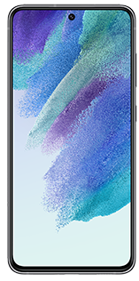
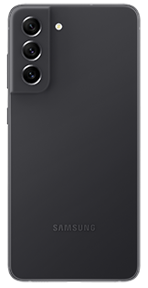
Product Features
Global Warming Impact of Part
Model name | SM-G990B (Galaxy S21 FE)
Processor | Qualcomm, SM8350, 2.84GHz,2.4GHz,1.8GHz Octa-Core 64bit
Dimension | 155.7 * 74.5 * 7.9mm
Display | OLED 6.4”
Memory | ROM 128GB, RAM 6GB
Battery | 4370 mAh
Camera | Main : 12.0M pixel / Sub : 32.0M pixel
Weight | Product&Acc. : 202.11g / PKG : 136.43g
Characterized Environment Impact
kg Sb eq.
kg SO₂ eq.
kgPO₄³-eq.
kg CO₂ eq.
kg CFC-11 eq.
kg 1,4-DB eq.
kg 1,4-DB eq.
kg 1,4-DB eq.
kg 1,4-DB eq.
kg C₂H₄ eq.
Notes:
Impact category
1) Abiotic depletion, 2) Acidification, 3) Eutrophication, 4) Global warming(GWP100), 5) Ozone layer depletion(ODP), 6) Human toxicity, 7) Fresh water aquatic ecotoxicity, 8) Marine aquatic ecotoxicity, 9) Terrestrial ecotoxicity, 10) Photochemical oxidation

